Slide 1
A dark and stormy night (patch Tuesday)
Colin Wilkins
@SysBehr | https://github.com/SysBehr/BehrNecessities
End User Computing Engineer

Slide 2
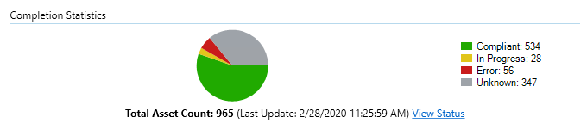

Update Compliance
Security teams pester us for timely patch compliance and supporting evidence
How do you know what your Autopilot-deployed, Co-managed clients are doing under the hood?
Supports the argument for Co-Management until we get DSC in Intune
How do we get higher compliance numbers, and quickly?
In a consumer world, we achieve this easily
We still need to meet business-case requirements
Problem 1:
Users don’t patch before they have to, so compliance lags based on deployment schedules
Availability and Maintenance Windows + Notifications
Problem 2:
Update Installation Failures keep clients in non-compliance
Network/WUA/OS Issues

Slide 3
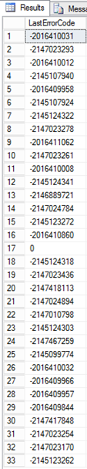
Detection
Select LastErrorCode, Count(*) as Count
from v_Update_ComplianceStatusReported
where LastErrorCode is not NULL
group by LastErrorCode
order by Count desc

Slide 4
Translation: How do we Interpret this?
Step 1: Convert Error Codes from ConfigMgr DB into human lingity
$ErrorCodes = Invoke-Sqlcmd -ServerInstance $ProviderMachineName -Database "CM_$SiteCode" -Query
"Select LastErrorCode from v_Update_ComplianceStatusReported where LastErrorCode is not NULL group by LastErrorCode"
$Errortable = @()
Foreach($ErrorCode in $ErrorCodes){
$description = Get-CMErrorMessage -ErrorCode $Errorcode.LastErrorCode
$errorObject = New-Object psobject
Add-Member -InputObject $errorObject -MemberType NoteProperty -Name ErrorCode –Value $Errorcode.LastErrorCode
Add-Member -InputObject $errorObject -MemberType NoteProperty -Name Description -Value $description
$Errortable += $errorObject
}
$Errortable | Format-Table -AutoSize
https://asdlabfunctions.azurewebsites.net/api/geterrormessage?exitcode=-2145124322
https://www.asquaredozen.com/2019/11/25/convert-configmgr-error-codes-to-plain-text-messages-for-reporting-part-2/
https://smsagent.blog/2015/06/25/translating-error-codes-for-windows-and-configuration-manager/

Slide 5
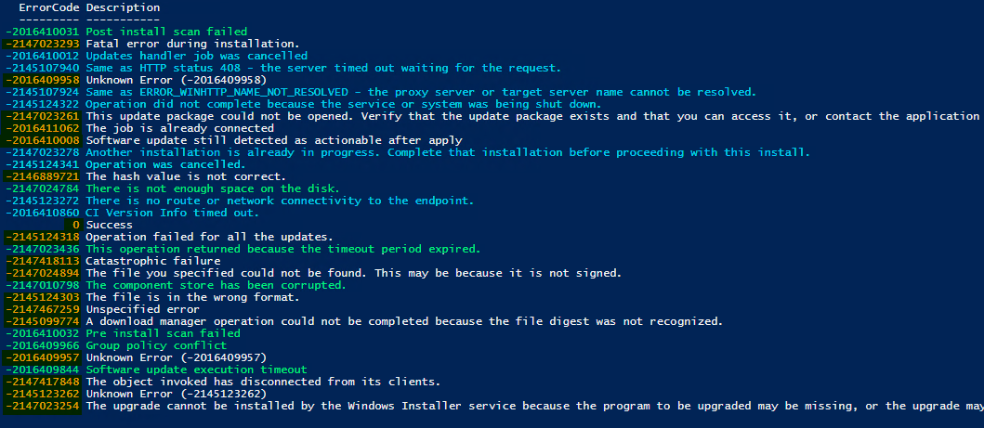
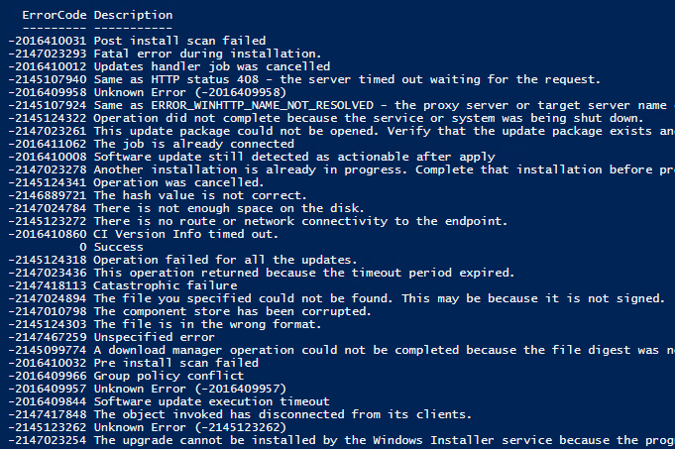
Translation: Continued
View all errors and error codes
Determine which can be “fixed” or remediated, which will resolve on their own, and which need further investigation
Create a deployment collection
Deploy fixes

Slide 6
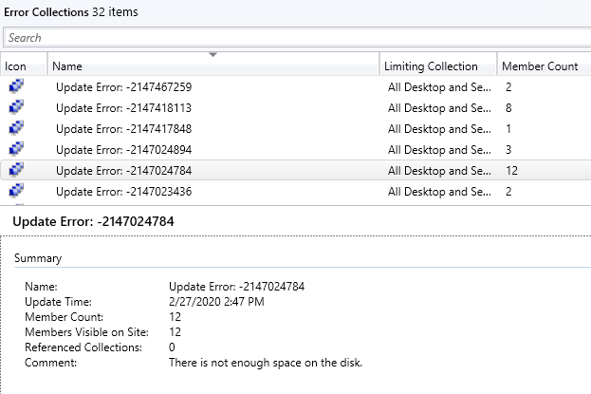
Step 2: Device Collections
WQL Query:
Select SMS_R_SYSTEM.ResourceID,SMS_R_SYSTEM.ResourceType, SMS_R_SYSTEM.Name, SMS_R_SYSTEM.SMSUniqueIdentifier, SMS_R_SYSTEM.ResourceDomainORWorkgroup, SMS_R_SYSTEM.Client
from sms_r_system
inner join SMS_UpdateComplianceStatus
on SMS_UpdateComplianceStatus.machineid = sms_r_system.resourceid
where SMS_UpdateComplianceStatus.LastErrorCode = $($ErrorCode.LastErrorCode)“
Caveat: WQL Query does not interpret in the console GUI

Slide 7
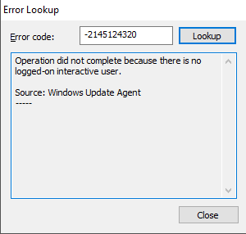
Identified Remediations
-2016410032 - Pre install scan failed
wuauclt.exe /ResetAuthorization
Trigger CCM schedules 108 and 113
wuauclt.exe /DetectNow
-2016410031 - Post install scan failed
wuauclt.exe /ResetAuthorization
Trigger CCM schedules 108 and 113
wuauclt.exe /ReportNow
-2147024784 - There is not enough space on the disk.
Clear CCMCache
Clear User Downloads (use a front-end/prompt)
Reset Servicing Base via DISM
-2016409844 - Software update execution timeout -2147023436 - This operation returned because the timeout period expired.
Check/Set update execution limits in ConfigMgr
-2147010798 - The component store has been corrupted.
winmgmt.exe /(verify/salvage/reset)repository
-2016409966 - Group policy conflict
Check Windows Update GPOs
-2145124320 – Operation did not complete… no interactive user
Delete the parent folder of where WindowsUpdateBox.exe is, in ..\SoftwareDistribution\Downloads
Nuke SoftwareDistribution folder (you’ll lose all cached update scans/history/staged content)
https://www.idkrtm.com/windows-update-commands/
https://sccmf12twice.com/2019/05/the-cure-for-your-ssu-fever/
https://github.com/SysBehr/BehrNecessities/tree/master/ConfigItems

Slide 8
Step 3: Lets Take Action
Convert the decimal error code in the ConfigMgr Database to the error code returned by the client
Create Configuration Items to act on these collections

Slide 9
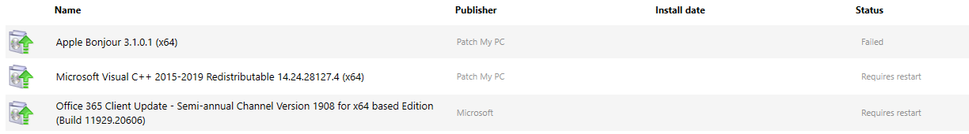
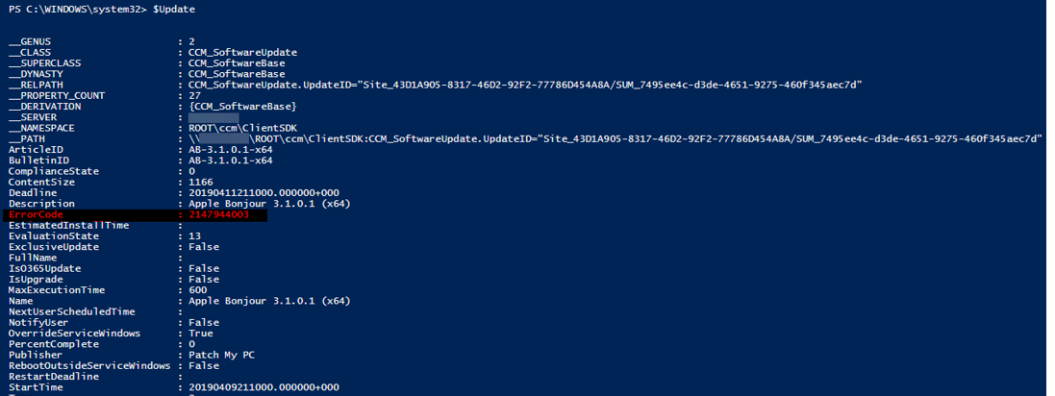
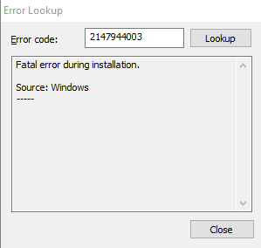


Slide 10
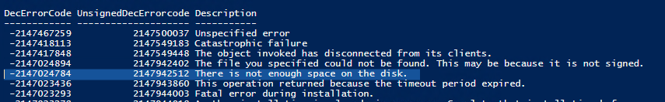
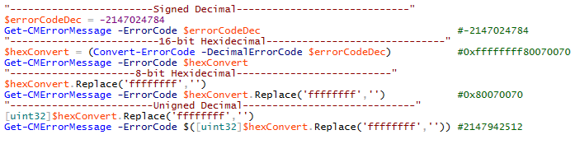
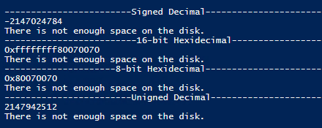
Conversion to Client Side Error Code (Server Side)
The error listed on the server is a signed integer (i.e. -2147024784)
The error listed on the client is an unsigned integer (i.e. 2147942512)
Signed Decimal > 16-bit Hex > 8-bit Hex > Unsigned Decimal
This was annoying.

Slide 11
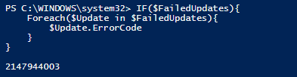
Conversion to Client Side Error Code (Client Side)
$FailedUpdates = Get-WmiObject “CCM_SoftwareBase" -Namespace "ROOT\ccm\ClientSDK" | Where-Object {$_.UpdateID -and $_.ErrorCode}
IF($FailedUpdates){
Foreach($Update in $FailedUpdates){
$Update.ErrorCode
}
}
Coming soon ™
- Software Center showing the “Human” readable error code

Slide 12
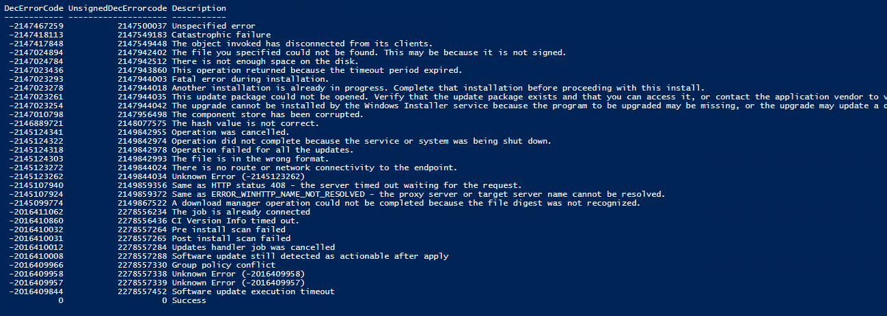
What are we left with?

Slide 13
Configuration Items
Two approaches:
Create individual CI’s for each error code
Create one CI to handle all error codes
Discovery AND Remediation

Slide 14
Discovery
$FailedUpdates = Get-WmiObject “CCM_SoftwareBase" -Namespace "ROOT\ccm\ClientSDK" | Where-Object {$_.UpdateID -and $_.ErrorCode}
IF($FailedUpdates){
Foreach($Update in $FailedUpdates){
Switch($Update.ErrorCode){
2149842976 {Return "Non-Compliant"}
2147944003 {Return "Non-Compliant"}
default {Return "Compliant"}
}
}
}ELSE{
Return "Compliant"
}
$FailedUpdates = Get-WmiObject “CCM_SoftwareBase" -Namespace "ROOT\ccm\ClientSDK" | Where-Object {$_.UpdateID -and $_.ErrorCode}
IF($FailedUpdates){
Foreach($Update in $FailedUpdates){
Switch($Update.ErrorCode){
2149842976 {Return "Non-Compliant"}
default {Return "Compliant"}
}
}
}ELSE{
Return "Compliant"
}

Slide 15
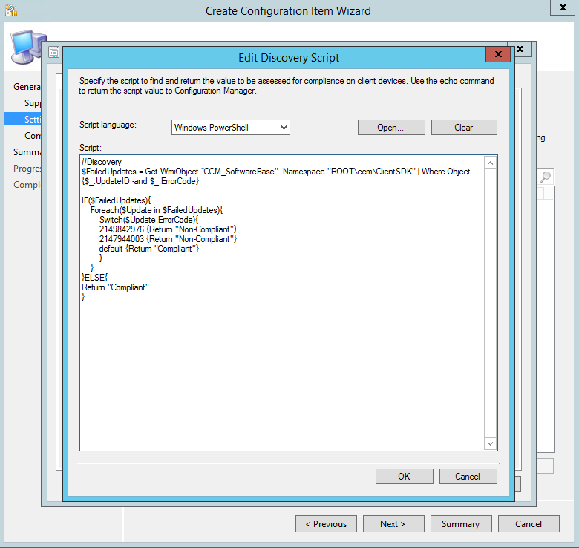

Slide 16
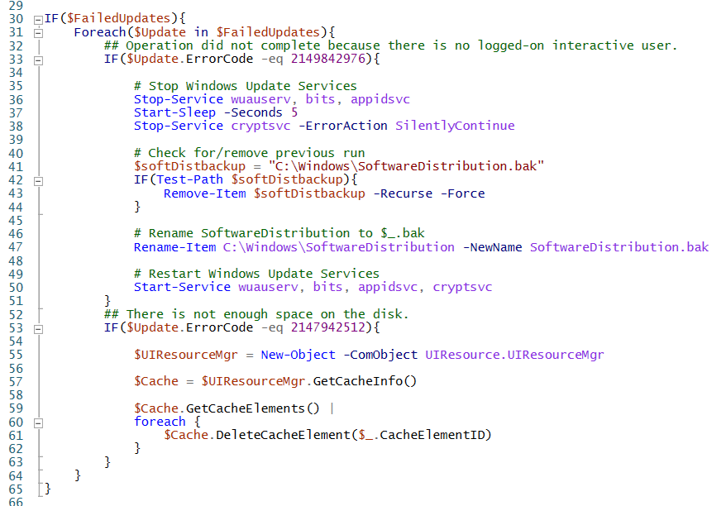
Remediation

Slide 17
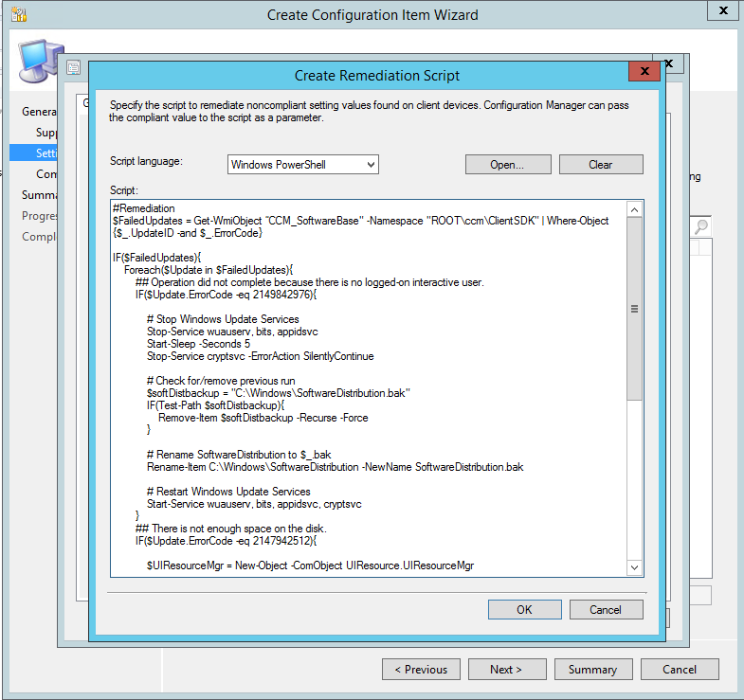

Slide 18
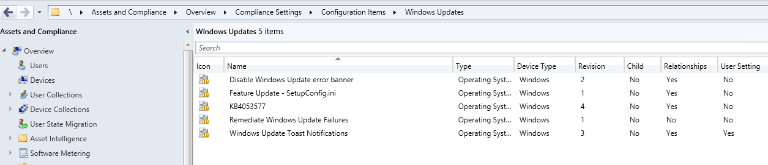

Slide 19
Script Info
https://github.com/SysBehr/BehrNecessities
I’ll post this soon as a Configuration Item/Baseline “plug-n-play” for some of these error codes

Slide 20
Feature Update/IPU failures
SetupDiag.exe
https://docs.microsoft.com/en-us/windows/deployment/upgrade/setupdiag
- Run in TS after the “Upgrade OS” step TS failure and copy to a Network Share for viewing
Deploy via app/package model and trigger via Configuration Item
Coming Soon ™
- Translating SetupDiag log/Feature Update error codes

Slide 21
Feature Update Customization (non-TS)
Customizing native Feature Updates (applies to ConfigMgr-deployed Feature Updates and Intune clients)
Customize Windows Setup options (Bitlocker, Priority, Compat settings, Drivers) without the use of a Task Sequence via setupconfig.ini
Do not set priority in Client Settings
https://www.asquaredozen.com/2019/08/25/windows-10-feature-updates-using-setupconfig-ini-to-manage-feature-updates-in-the-enterprise/

Slide 22
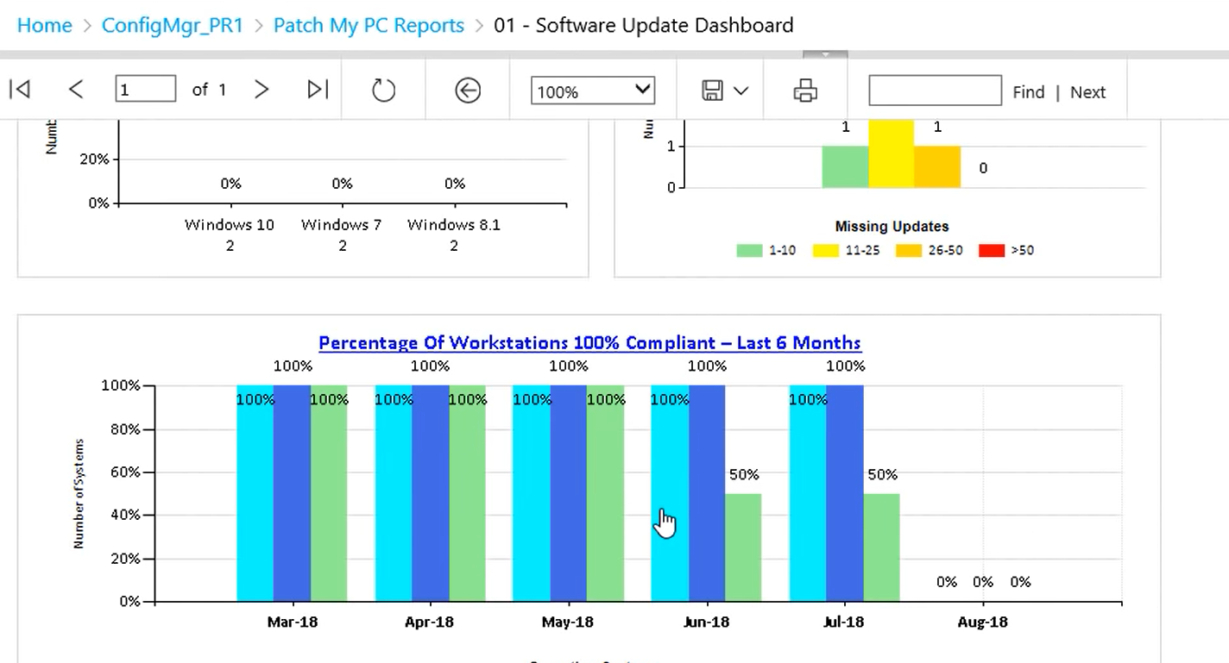
Reporting
https://setupconfigmgr.com/free-software-update-compliance-dashboard-reports-for-microsoft-sccm

Slide 23
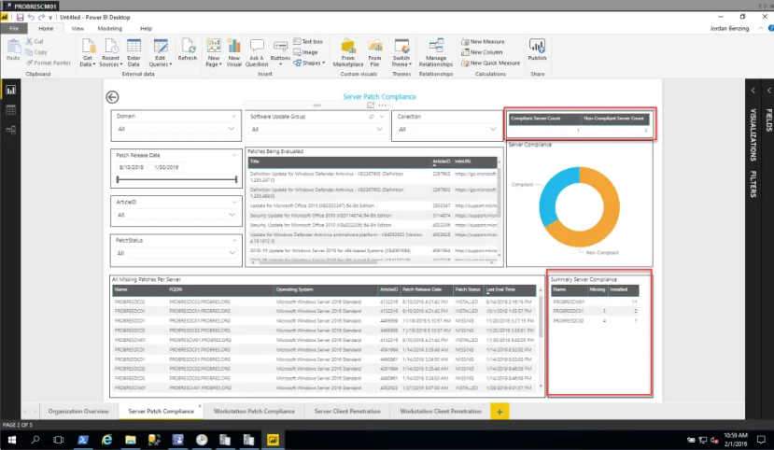
Reporting
https://www.scconfigmgr.com/2019/02/01/patch-compliance-reporting-in-powerbi-report-version-2-5/

Slide 24
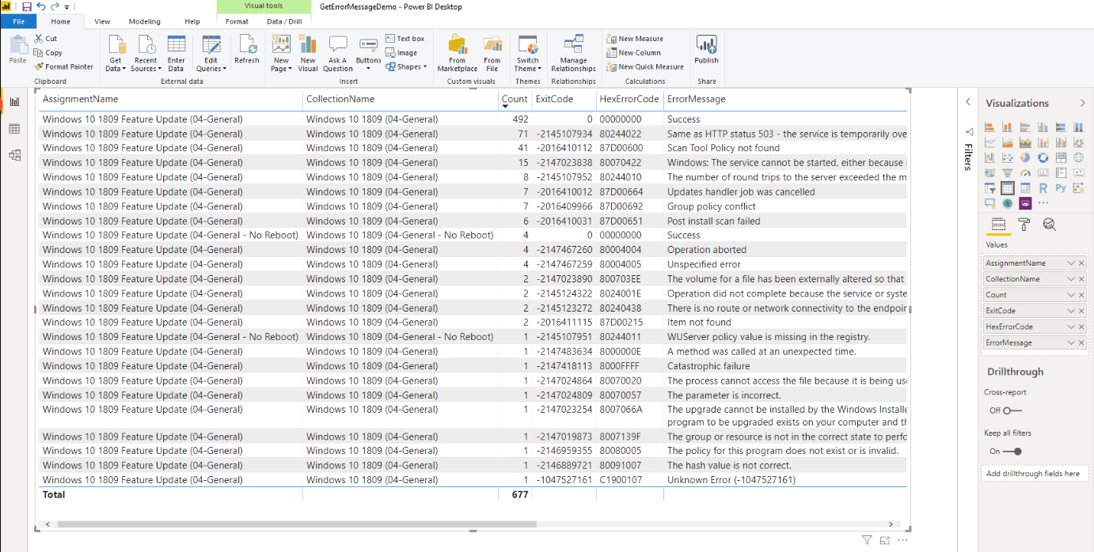
Reporting
https://www.asquaredozen.com/2019/11/25/convert-configmgr-error-codes-to-plain-text-messages-for-reporting-part-3/

Slide 25
SUP Setup & Maintenance
https://setupconfigmgr.com/how-to-deploy-software-updates-using-microsoft-sccm
https://damgoodadmin.com/2017/11/05/fully-automate-software-update-maintenance-in-cm/

Slide 26
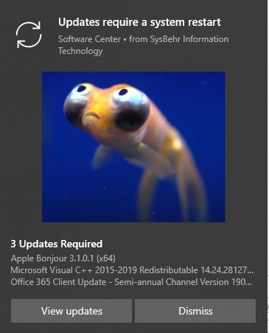
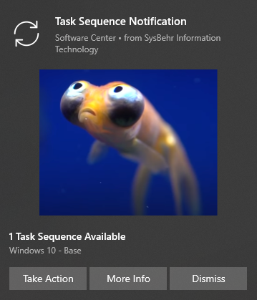
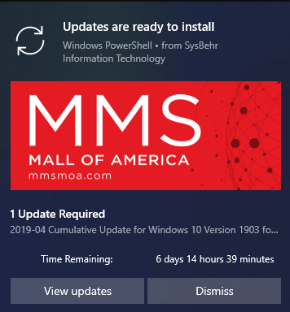
Notifying Users of Available/Required Updates (Outside of ConfigMgr Native Functionality)
https://github.com/SysBehr/BehrNecessities/tree/master/ConfigItems/Windows%20Update%20Toasts

Slide 27
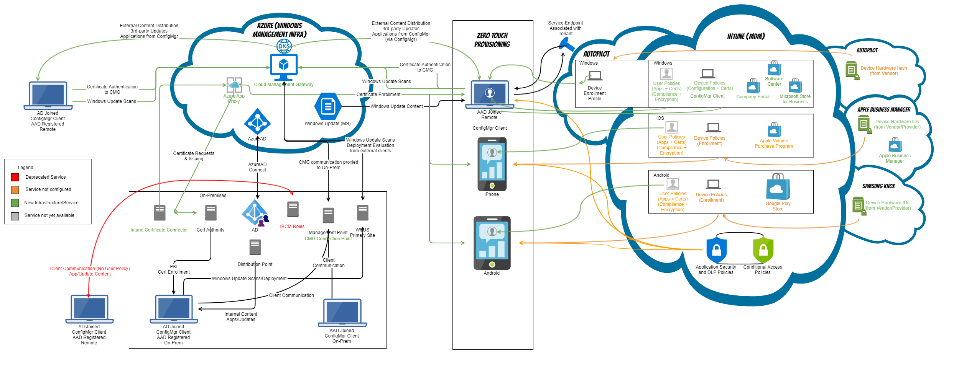
Bonus Slide – Co-Management Diagram

